Slide 1
Database Systems
COMP 3010E FALL 2025
Lecture 11 Indexing

Slide 2
Agenda
What is indexing
B+ tree index
Hash Index

Slide 3
Indexed File Organizations
Indexed File Organization:
  the storage of records with an index that allows software to locate individual records
Index:
  a table or other data structure used to determine in a file the location of records that satisfy some condition
Primary keys are automatically indexed
Other fields or combinations of fields can also be indexed

Slide 4
Ordered Indices
In an ordered index, index entries are stored sorted on the search key value.
Clustering index: in a sequentially ordered file, the index whose search key specifies the sequential order of the file.
  Also called primary index
  The search key of a primary index is usually but not necessarily the primary key.
Secondary index: an index whose search key specifies an order different from the sequential order of the file. Also called
nonclustering index.
Index-sequential file: sequential file ordered on a search key, with a clustering index on the search key.

Slide 5
Dense Index Files
Dense index — Index record appears for every search-key value in the file.
E.g. index on ID attribute of instructor relation

Slide 6
Dense Index Files (Cont.)
Dense index on dept_name, with instructor file sorted on dept_name

Slide 7
Sparse Index Files
Sparse Index: contains index records for only some search-key values.
  Applicable when records are sequentially ordered on search-key
To locate a record with search-key value K we:
  Find index record with largest search-key value < K
  Search file sequentially starting at the record to which the index record points

Slide 8
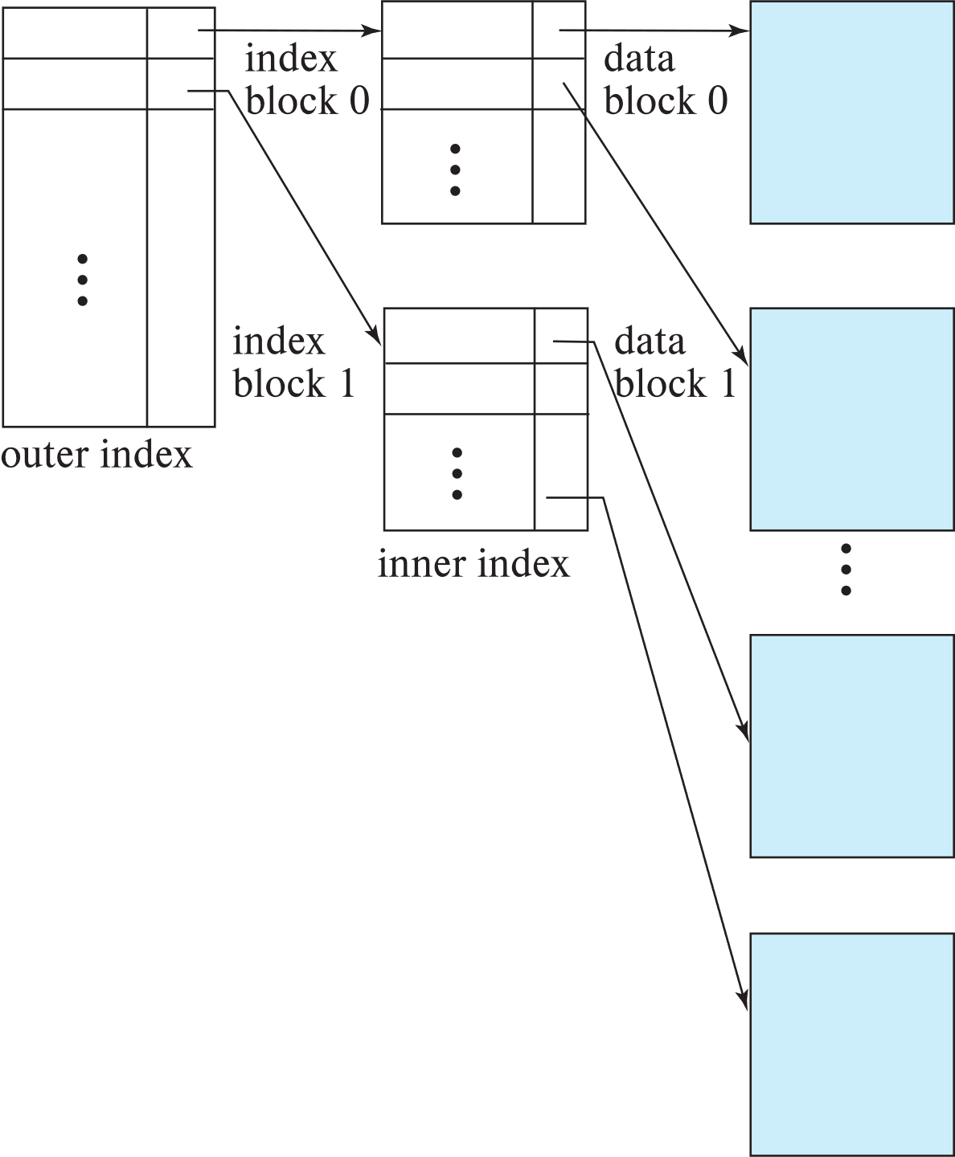
Sparse Index Files (Cont.)
Compared to dense indices:
  Less space and less maintenance overhead for insertions and deletions.
  Generally slower than dense index for locating records.
Good tradeoff:
  for clustered index: sparse index with an index entry for every block in file, corresponding to least search-key value in the block.
  For unclustered index: sparse index on top of dense index (multilevel index)

Slide 9
B⁺-Tree Index Files
Disadvantage of indexed-sequential files
  Performance degrades as file grows, since many overflow blocks get created.
  Periodic reorganization of entire file is required.
Advantage of B⁺-tree index files:
  Automatically reorganizes itself with small, local, changes, in the face of insertions and deletions.
  Reorganization of entire file is not required to maintain performance.
(Minor) disadvantage of B⁺-trees:
  Extra insertion and deletion overhead, space overhead.
Advantages of B⁺-trees outweigh disadvantages
  B⁺-trees are used extensively

Slide 10
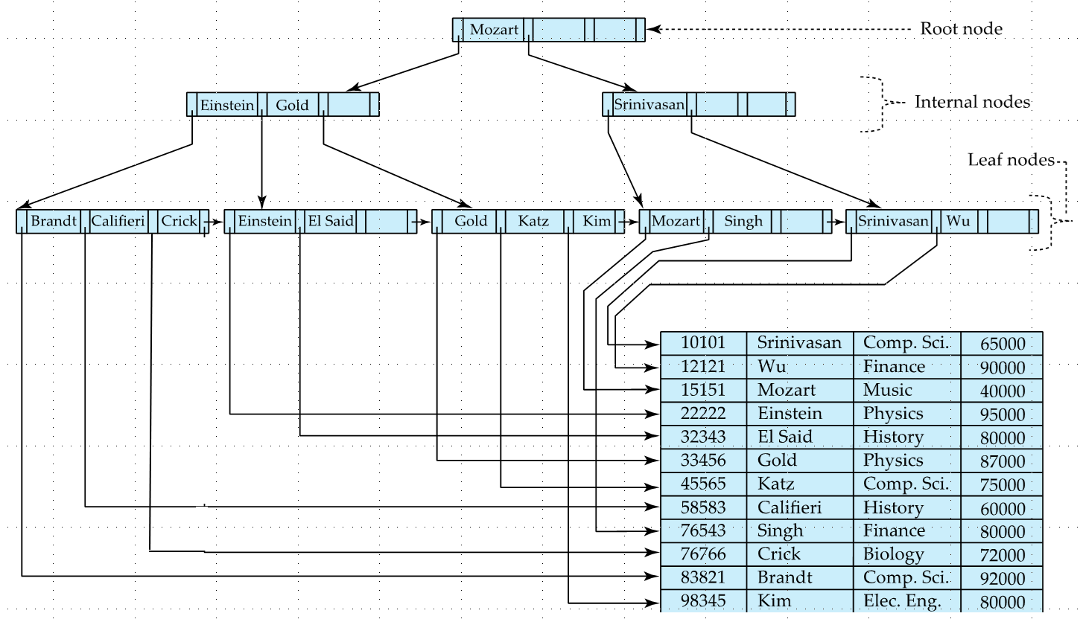
Example of B⁺-Tree

Slide 11
B⁺-Tree Index Files (Cont.)
A B⁺-tree is a rooted tree satisfying the following properties:
All paths from root to leaf are of the same length
Each node that is not a root or a leaf has between ⎡n/2⎤ and n children.
A leaf node has between ⎡(n–1)/2⎤ and n–1 values
Special cases:
  If the root is not a leaf, it has at least 2 children.
  If the root is a leaf (that is, there are no other nodes in the tree), it can have between 0 and (n–1) values.

Slide 12
B⁺-Tree Node Structure
Typical node
  K_{i} are the search-key values
  P_{i} are pointers to children (for non-leaf nodes) or pointers to records or buckets of records (for leaf nodes).
The search-keys in a node are ordered
K₁ < K₂ < K₃ < . . . < K_{n–1}
(Initially assume no duplicate keys, address duplicates later)

Slide 13
Leaf Nodes in B⁺-Trees
Properties of a leaf node:
For i = 1, 2, . . ., n–1, pointer P_{i} points to a file record with search-key value K_{i},
If L_{i}, L_{j} are leaf nodes and i < j, L_{i}’s search-key values are less than or equal to L_{j}’s search-key values
P_{n} points to next leaf node in search-key order

Slide 14
Non-Leaf Nodes in B⁺-Trees
Non leaf nodes form a multi-level sparse index on the leaf nodes.
For a non-leaf node with m pointers:
  All the search-keys in the subtree to which P₁ points are less than K₁
  For 2 ≤ i ≤ n – 1, all the search-keys in the subtree to which P_{i} points have values greater than or equal to K_{i–1} and less than K_{i}
  All the search-keys in the subtree to which P_{n} points have values greater than or equal to K_{n–1}
  General structure

Slide 15
Example of B⁺-tree
B⁺-tree for example (n = 6)
Leaf nodes must have between 3 and 5 values
(⎡(n–1)/2⎤ and n –1, with n = 6).
Non-leaf nodes other than root must have between 3 and 6 children
(⎡(n/2)⎤ and n with n =6).
Root must have at least 2 children.

Slide 16
Observations about B⁺-trees
Since the inter-node connections are done by pointers, “logically” close blocks need not be “physically” close.
The non-leaf levels of the B⁺-tree form a hierarchy of sparse indices.
The B⁺-tree contains a relatively small number of levels
    Level below root has at least 2* ⎡n/2⎤ values
    Next level has at least 2* ⎡n/2⎤ * ⎡n/2⎤ values
    .. etc.
  If there are K search-key values in the file, the tree height is no more than ⎡ log_{⎡n/2⎤}(K)⎤
  thus searches can be conducted efficiently.
Insertions and deletions to the main file can be handled efficiently, as the index can be restructured in logarithmic time (as we shall see).

Slide 17
Queries on B⁺-Trees

Slide 18
Queries on B⁺-Trees (Cont.)
Range queries find all records with search key values in a given range
  findRange(lb, ub) returns set of all such records that lb <= x <= ub
  Real implementations usually provide an iterator interface to fetch matching records one at a time, using a next() function

Slide 19
Example
B+Tree (n=4)
13
7
23 31 43
Non-leaves
leaves
2 3 5
7 11
13 17 19
23 29
31 37 41
43 47

Slide 20
Updates on B⁺-Trees: Insertion
Assume record already added to the file. Let
  pr be pointer to the record, and let
  v be the search key value of the record
Find the leaf node in which the search-key value would appear
  If there is room in the leaf node, insert (v, pr) pair in the leaf node
  Otherwise, split the node (along with the new (v, pr) entry) as discussed in the next slide, and propagate updates to parent nodes.

Slide 21
Updates on B⁺-Trees: Insertion (Cont.)
Splitting a leaf node:
  take the n (search-key value, pointer) pairs (including the one being inserted) in sorted order. Place the first ⎡n/2⎤ in the original node, and the rest in a new node.
  let the new node be p, and let k be the least key value in p. Insert (k,p) in the parent of the node being split.
  If the parent is full, split it and propagate the split further up.
Splitting of nodes proceeds upwards till a node that is not full is found.
  In the worst case the root node may be split increasing the height of the tree by 1.
Result of splitting node containing Brandt, Califieri and Crick on inserting Adams
Next step: insert entry with (Califieri, pointer-to-new-node) into parent

Slide 22
B⁺-Tree Insertion
Affected nodes
B⁺-Tree before and after insertion of “Adams”

Slide 23
B⁺-Tree Insertion
B⁺-Tree before and after insertion of “Lamport”
Affected nodes
Affected nodes

Slide 24
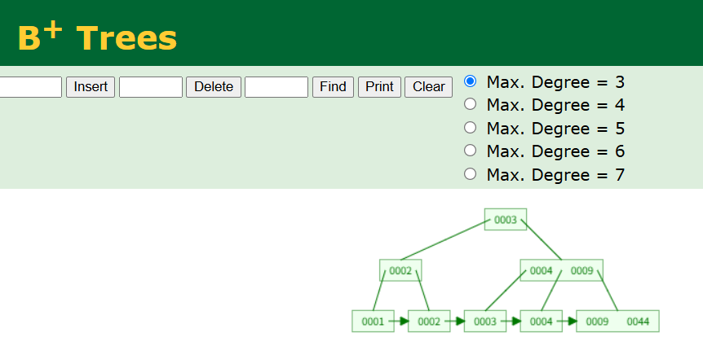
Example website
https://www.cs.usfca.edu/~galles/visualization/BPlusTree.html

Slide 25
B+tree Insertion
13
7
23 31 43
2 3 5
7 11
13 17 19
23 29
31 37 41 43 47

Slide 26
Example
13
N = 4 (four pointers per node)
7
23 31 43
2 3 5
7 11
13 17 19
23 29
31 37 41 43 47
31 37
40
41

Slide 27
Example
13
40
23 31
43
7
23 31 43
2 3 5
7 11
13 17 19
23 29
43 47
31 37
40 41

Slide 28
Final result
13 40
7
23 31
43
2 3 5
7 11
13 17 19
23 29
43 47
31 37
40 41

Slide 29
Exercise:
Show the B+-tree after inserting 8
13
7
23 31 43
2 3 5
7 11
13 17 19
23 29
31 37 41 43 47

Slide 30
Exercise:
Show the B+-tree after inserting 8
13
7
23 31 43
2 3 5
7 8 11
13 17 19
23 29
31 37 41 43 47

Slide 31
Exercise:
Show the B+-tree after inserting 8
13
7
23 31 43
2 3 5
7 11
13 17 19
23 29
31 37 41 43 47

